Slide 1


Analysis and Prediction of Wine Quality Using Machine Learning

Slide 2

Wine Quality Analysis: Frequency and Quantity Distribution
The most frequently occurring wine quality is: 5
Highest number in the quality column: 8
Lowest number in the quality column: 3

Slide 3
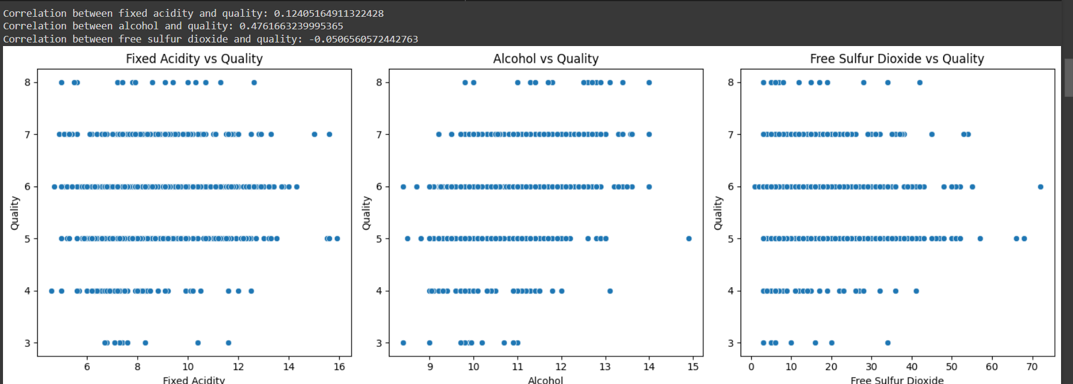
Wine Quality Analysis: Correlations and Insights
There is a weakly positive correlation between fixed acidity and quality, a positive correlation between alcohol and quality, and a weakly negative correlation between sulfur dioxide and quality.

Slide 4

Average Residual Sugar in Best and Lowest Quality Wines
Best and lowest quality wine: 8 and 3, respectively
Average residual sugar for best quality wine: 2.58
Average residual sugar for lowest quality wine: 2.64

Slide 5
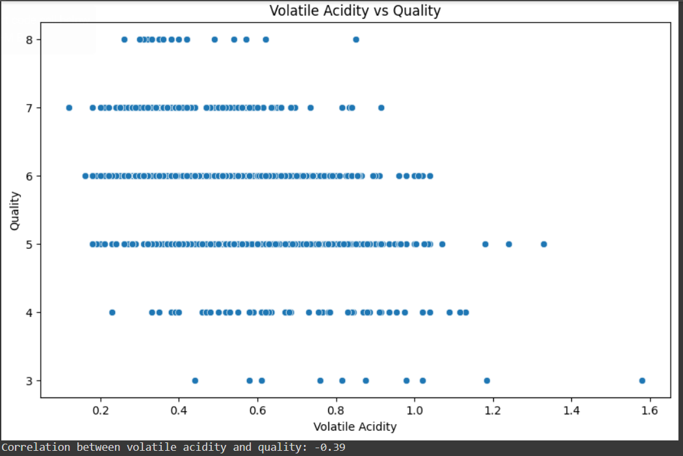
Impact of Volatile Acidity on Wine Quality
The scatter plot shows the relationship between volatile acidity and wine quality.
There is a negative correlation between volatile acidity and wine quality, with a correlation coefficient of -0.39.
The quality ratings range from 3 to 8, with most wines having quality ratings of 5 and 6.
Volatile acidity values in the dataset range approximately from 0.2 to 1.6.

Slide 6
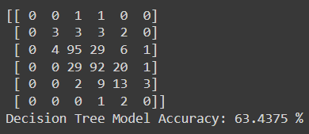
Decision Tree Model
Accuracy using Decision Tree model: 63.4375%

Slide 7
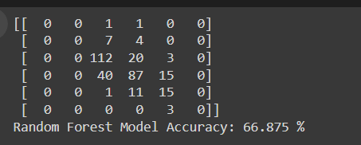
Random Forest Model
Accuracy using Random Forest model: 66.875%
This shows that using a Random Forest Classifier was more accurate in this case

